Slide 1
Getting your hospital ready for a surge
Nwando Anyaoku, md, Mph, MBA
Executive Medical Director Pediatrics Swedish Health Services

Slide 2
Incoming…..
The first US COVID19 case was admitted to a facility just about 20 miles north of Swedish hospital in January 2020
By March the virus was spreading rapidly and the now famous UW IHME model predicted that our health system may soon be overwhelmed
The WHO declared a global pandemic and the governor of WA issued a statewide stay at home order
A lot was unknown. Fear, rumors and anxiety were extremely high

Slide 3
Planning in chaos
In response Swedish activated our Hospital Incident Command System (HICS)
The HICS structure is a model for emergency preparedness for hospitals which was developed in California
The goal is to provide structure and order in situations of chaos
The fundamental structure of HICS has 5 or 6 major components
  The components can be adapted or filled out based on your own local resources
  SPACE * STAFF * STUFF

Slide 4
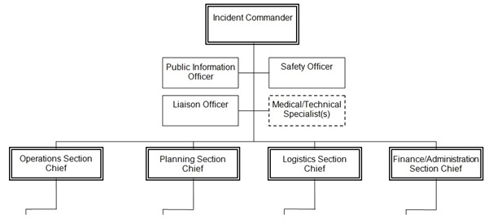

Slide 5
SMG Incident Command Center
Incident Commander – person responsible for overseeing and directing actions/resources.
Operations officer- person responsible for managing any patient/family impact or medical related issues.
Information officer- person responsible for any communications for internal and external groups.
Safety officer - person responsible for overseeing any safety issues for staff, patients, and visitors and liaison with security.
Logistics and Finance officer- person responsible for ensuring resources and finances meet the operational objectives.
Planning officer- person responsible for tracking, documenting plan and managing information back to the teams.

Slide 6
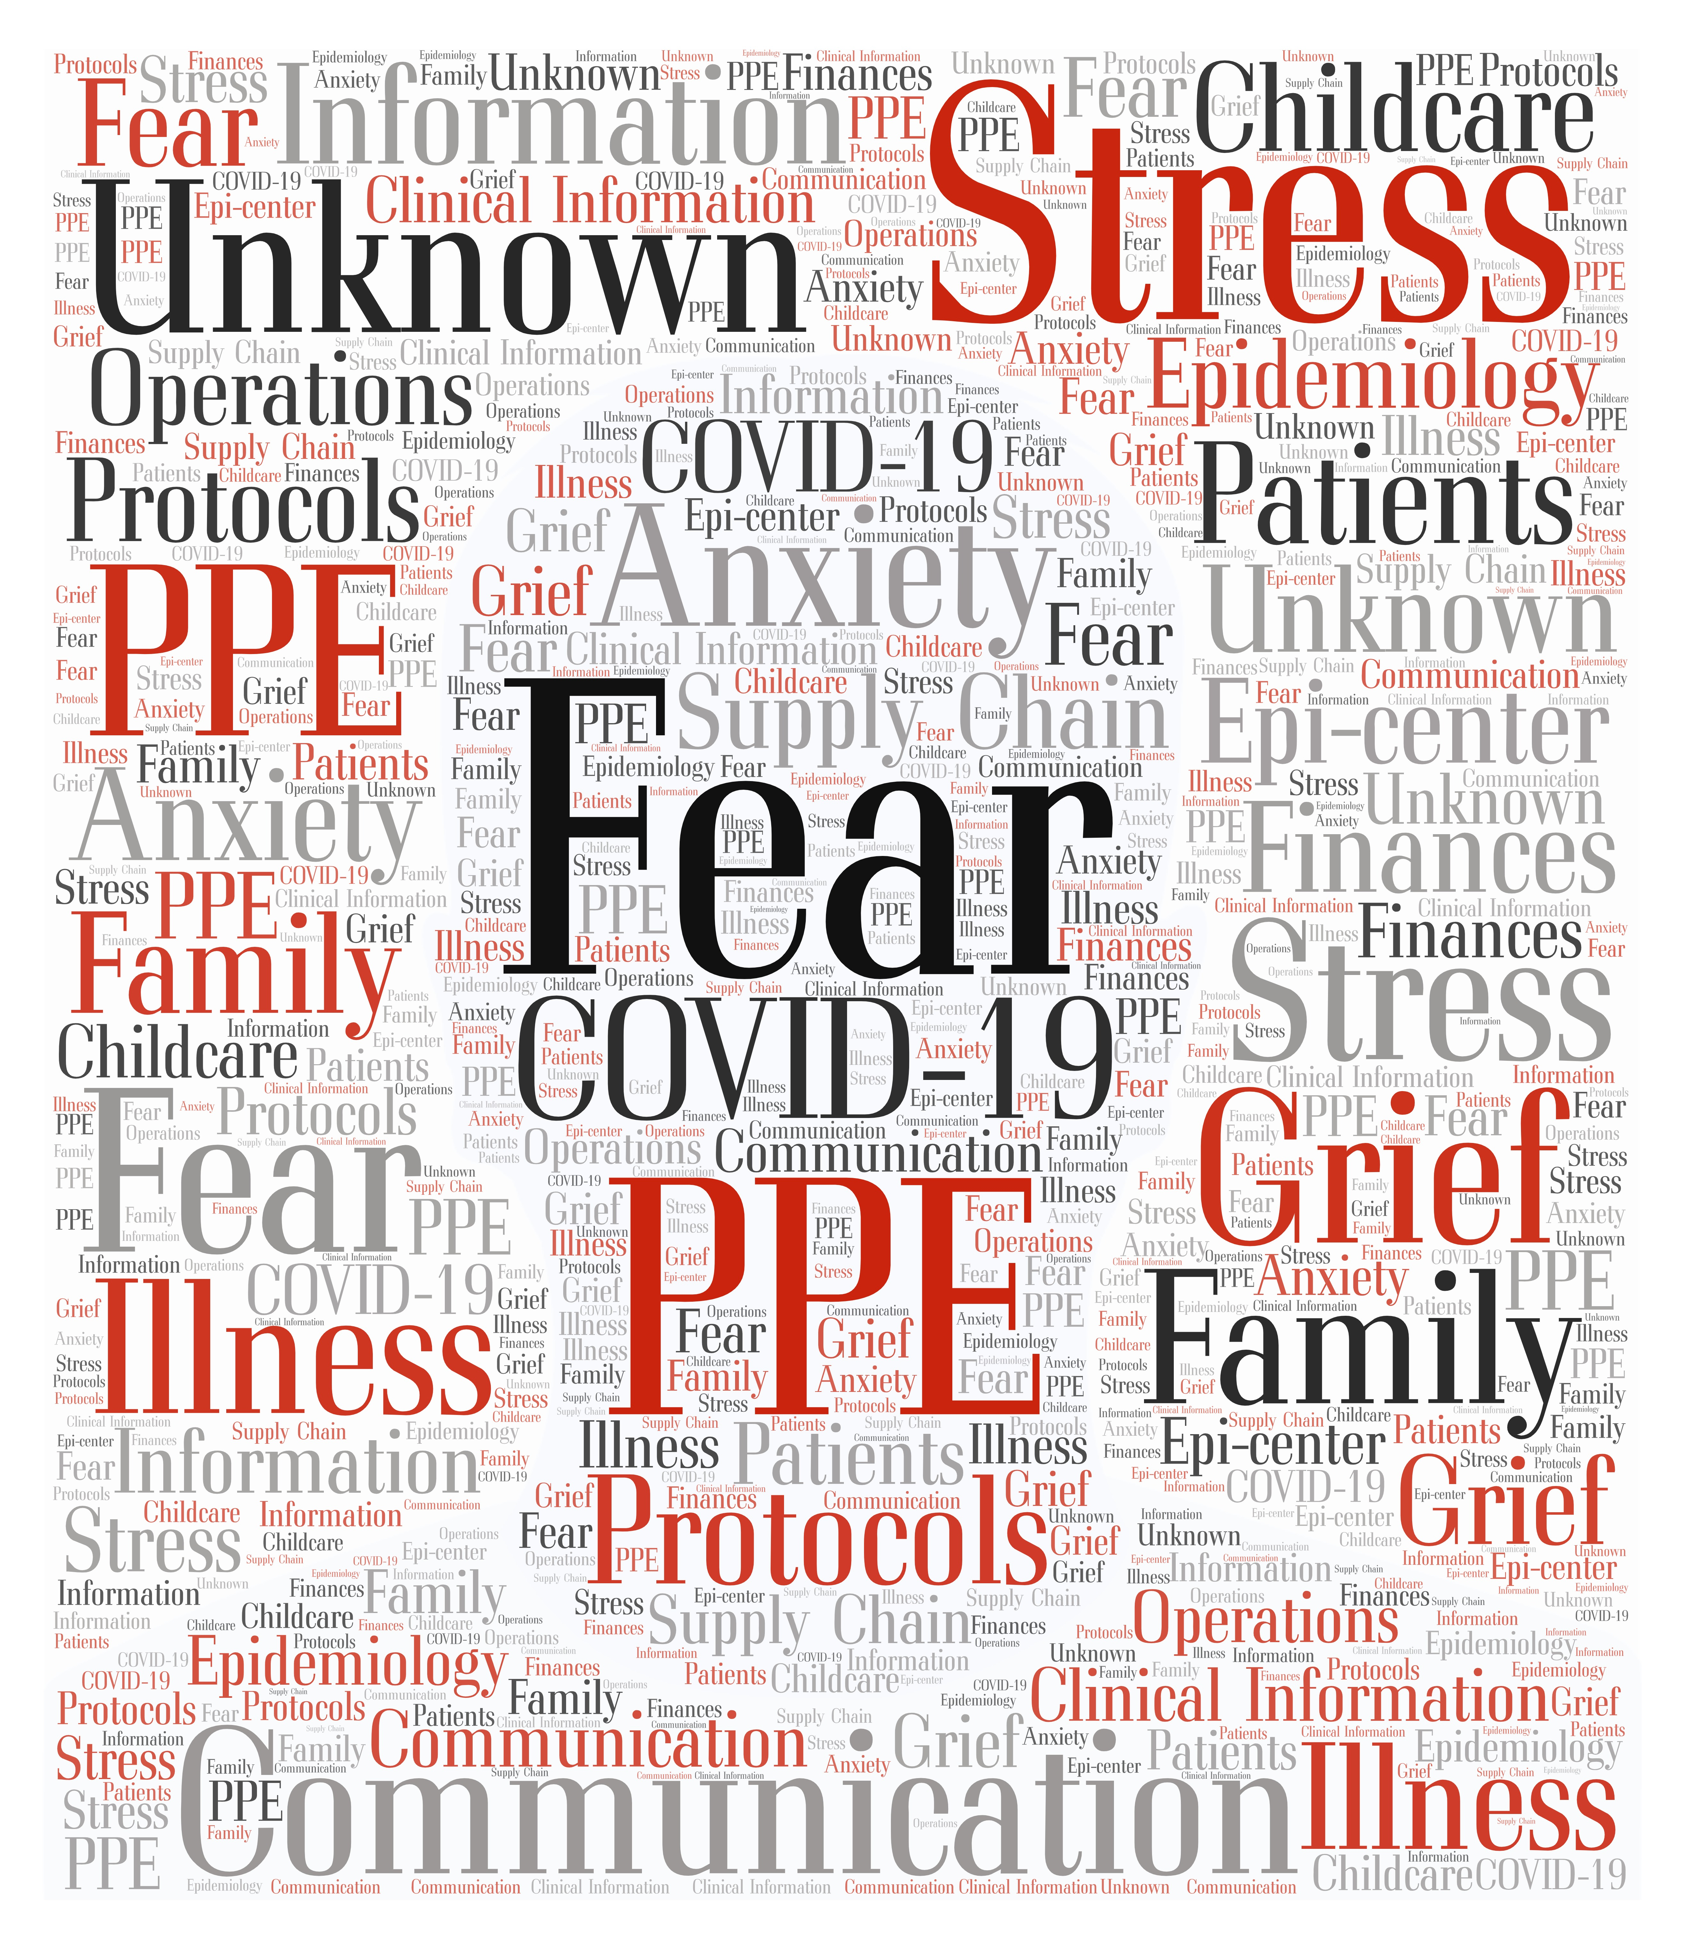

Slide 7
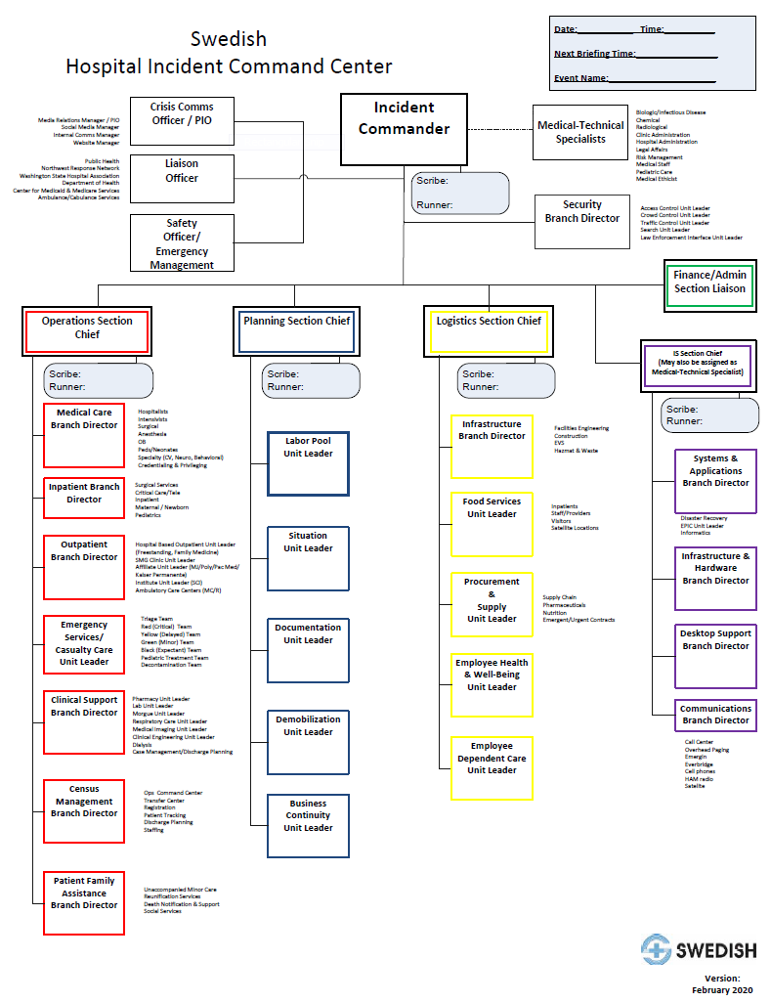

Slide 8
Some areas of attention
Covid19 epidemiology and clinical information
Bed and ventilator management
Staffing management
Visitor policies & Testing protocols
Town halls (virtual)
Infection control policies
Care pathways
PPE and supply chain issues
Communication: Internal and external
Liaison with other organizations and government
Staff (caregiver) wellbeing
Community engagement

Slide 9


Slide 10
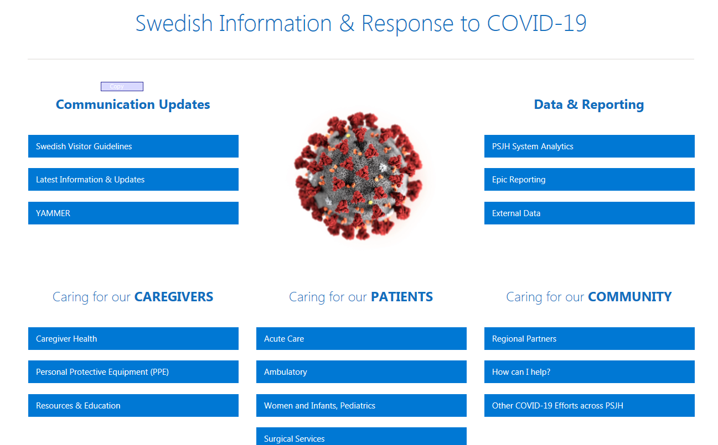

Slide 11
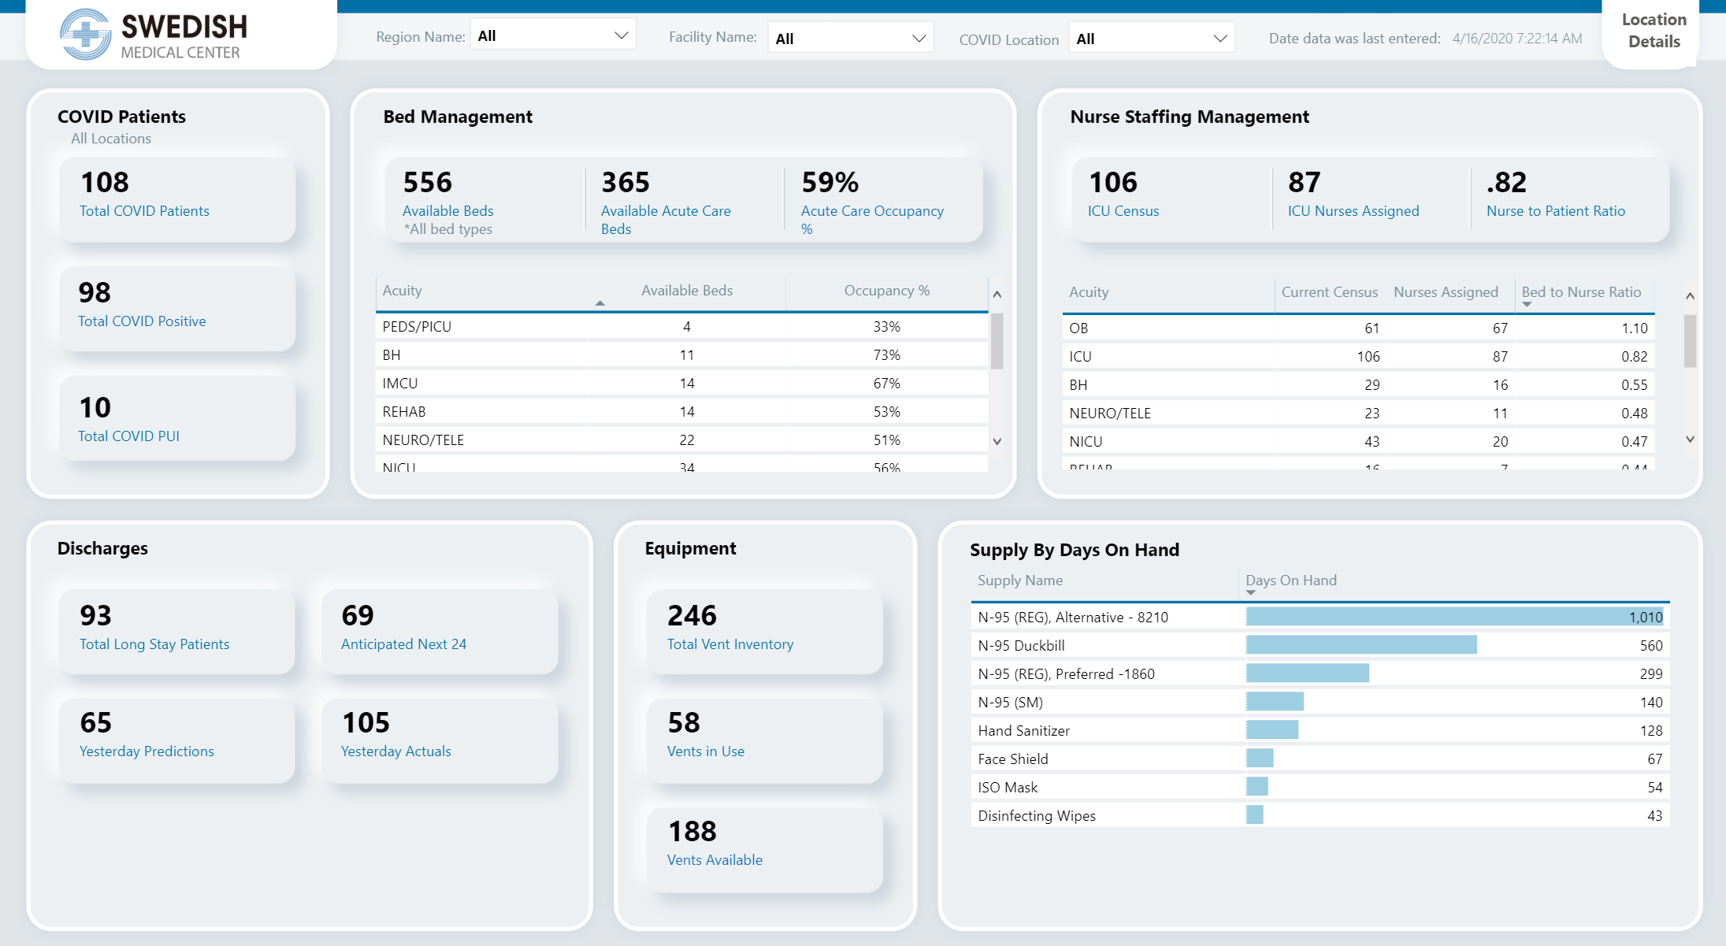

Slide 12
Children and COVID Planning
Incidence in children lower than adults
Pathway of care for children
  In ER, Inpatient, Ambulatory settings
Preadmission testing of child and parent
Exception to general hospital policy – allows 2 visitors
Crisis standards of care
  Plan to consolidate pediatric hospital care to children’s hospitals
  Free up hospital beds and vents for adult patients

Slide 13
Pregnancy and Childbirth Planning
Special isolation rooms
Pre-admission testing for pregnant moms especially C-sections
  Not required for vaginal
Management of newborn of COVID positive mom
  Initially recommended separating from mom
  Not required
  Attention to sanitizing space
  Follow up testing of newborn
Planning for rapid discharge
Visiting policy
  Exception to hospital policy: 2 allowed
  Testing partners

Slide 14
Lessons Learned
3 major lessons learned from our experience
  Communicate clearly and often
  Delegate authority
  Focus on people and sustainability

Slide 15
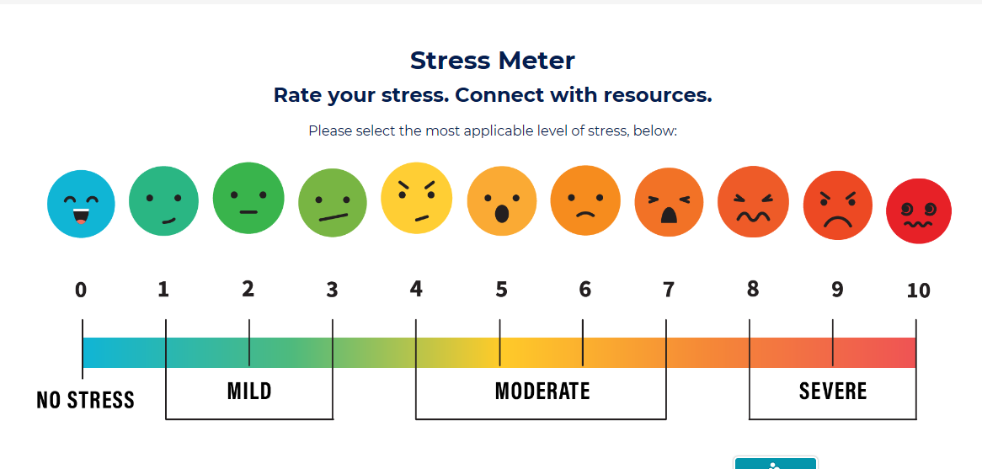

Slide 16
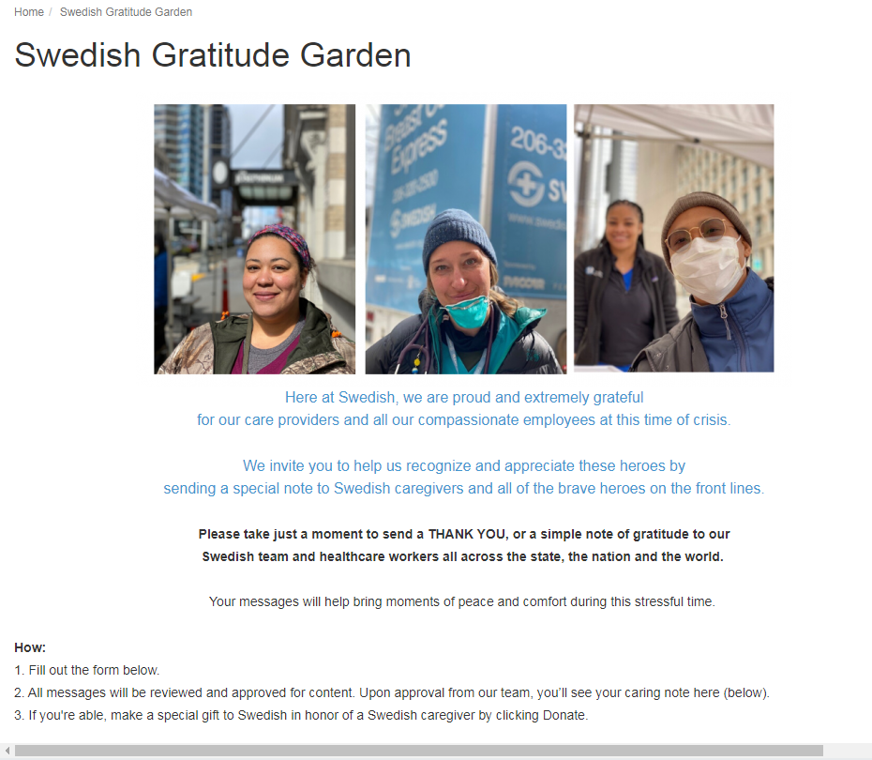

Slide 17


Slide 18
Thank you!

